Slide 1
Meiosis

Slide 2
Learning Objectives
Learners should be able to demonstrate and apply their knowledge and understanding of:
the significance of meiosis in life cycles
  To include the production of haploid cells and genetic variation by independent assortment and crossing over.
the main stages of meiosis
  To include interphase, prophase 1, metaphase 1, anaphase 1, telophase 1, prophase 2, metaphase 2, anaphase 2, telophase 2 and the term homologous chromosomes.

Slide 3
haploid homologous centromere chromosome
chromatid homologous pair nuclear envelope diploid

Slide 4
Why Meiosis?
In sexual reproduction two gametes fuse to give rise to new offspring
To maintain the chromosome number in the adults of a species the number must be halved at some stage in the life cycle
Meiotic division halves the chromosome number

Slide 5
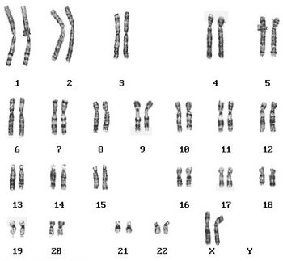

Slide 6
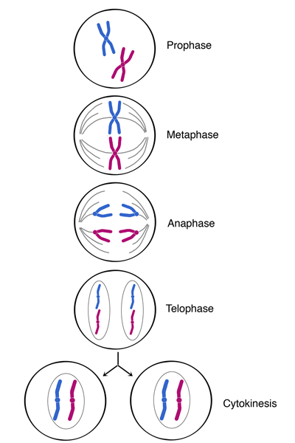
Mitosis

Slide 7

Meiosis I

Slide 8
Meiotic division
Meiosis I – the first meiotic division
Prophase I, Metaphase I, Anaphase I and Telophase I
Prophase I – homologous pairs form a bivalent (a process called synapsis) and crossing over may occur if chiasmata form; portions of chromosomes may be “swapped”
Homologous pairs are separated
Meiosis II – the second meiotic division
Chromatids are separated
Four daughter cells are formed – a tetrad

Slide 9
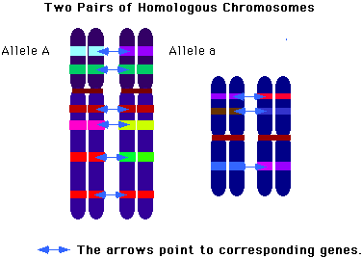
Homologous chromosomes
The 22 pairs of autosomes are known as homologous chromosomes – they have the same genes in the same places
Diploid cells have two sets of chromosomes, one set provided by each parent.
(Homologous chromosomes determine the same characteristics although the alleles carried may not be identical)
Each daughter cell produced by meiosis receives one from each homologous pair

Slide 10
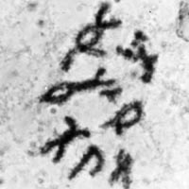
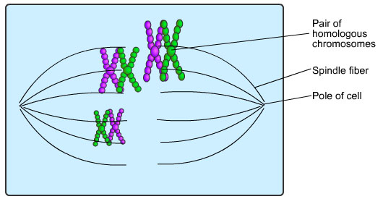
Prophase 1

Slide 11
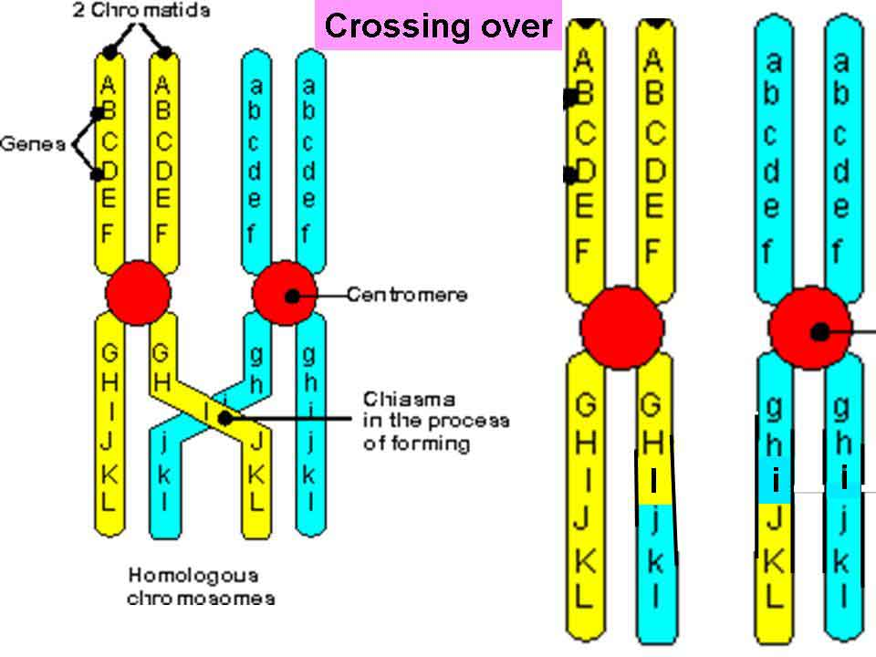
Prophase 1
Crossing over- chiasma

Slide 12
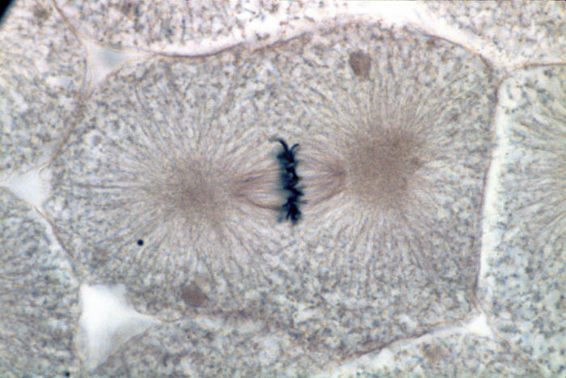
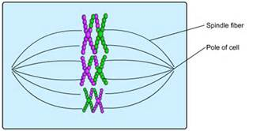
Metaphase 1

Slide 13
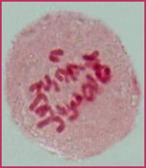
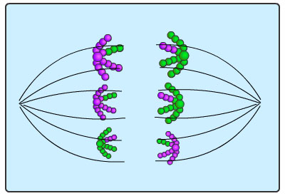

Anaphase 1
Homologous chromosomes are pulled apart to the poles

Slide 14
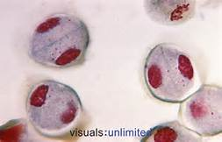
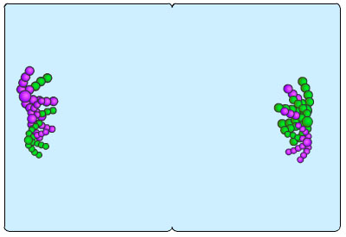
Telophase 1

Slide 15
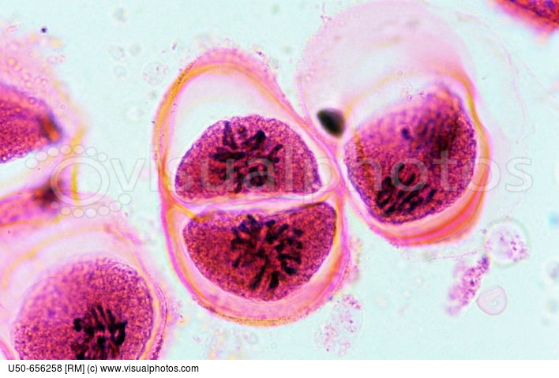
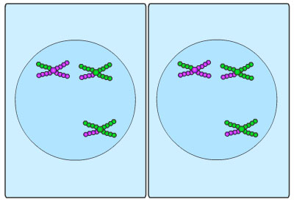
Prophase 2

Slide 16
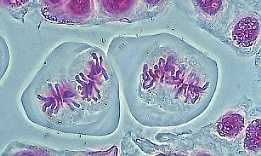
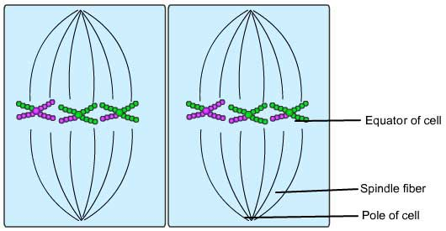
Metaphase 2

Slide 17
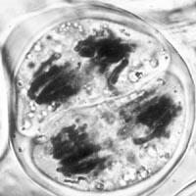
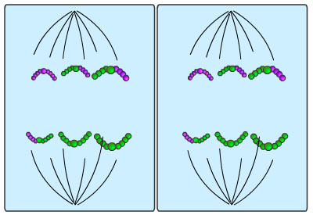
Anaphase 2

Slide 18
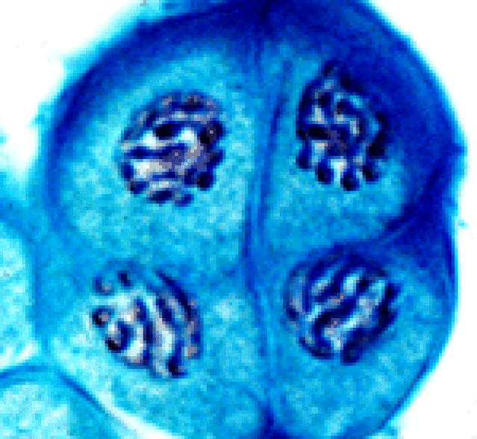
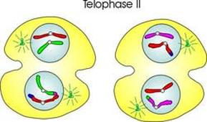
Telophase 2

Slide 19
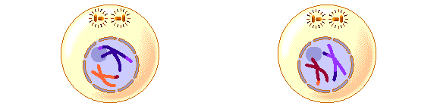
Meiosis I
Meiosis II
Slides
animated

Slide 20
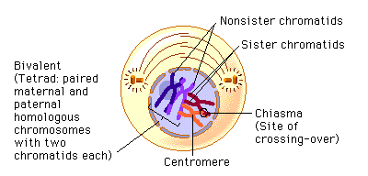
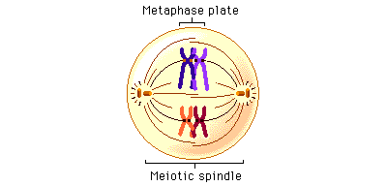
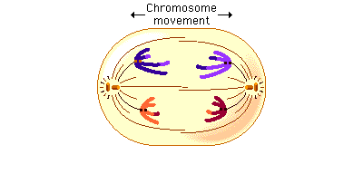
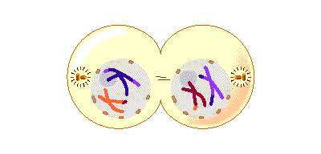
Meiosis I

Slide 21
Meiosis II

Slide 22
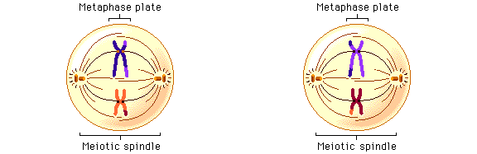
Meiosis II

Slide 23
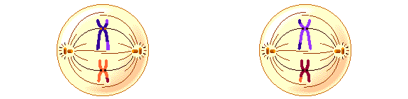
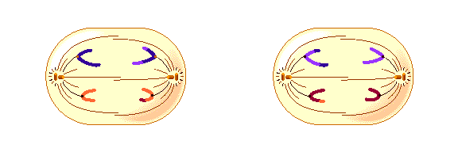
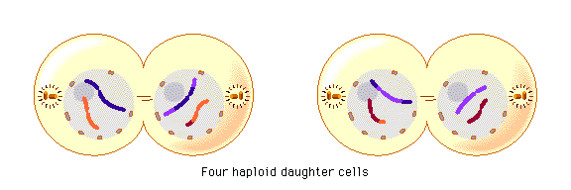

Slide 24
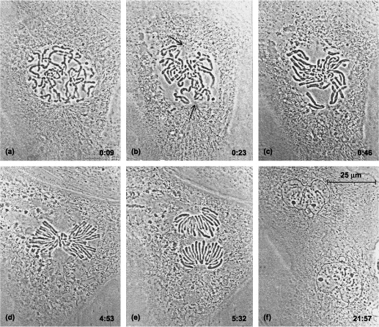

Slide 25
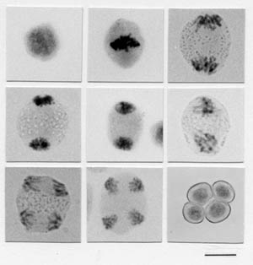
Very straightforward
animation
John Kyrk’s
animation
Cells alive
Mini Meiosis Quiz

Slide 26
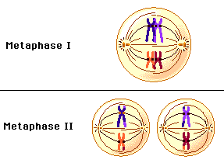
Comparing metaphase 1 and 2 in meiosis

Slide 27
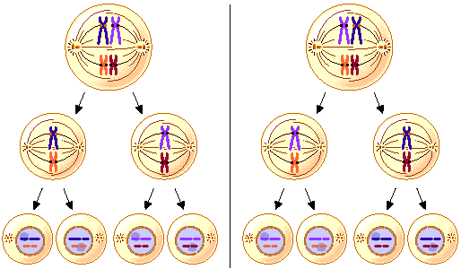
One way meiosis generates genetic variability is through the different ways in which maternal and paternal chromosomes are combined in the daughter cells.
Independent assortment
The number of possible chromosome combinations in the haploid nuclei is potentially very large. In general, the number of possible chromosome combinations is 2n, where n is the number of chromosome pairs.
For example, in fruit flies, which have 4 chromosome pairs, the number of possible combinations is 2n, or 16. For humans, with 23 chromosome pairs, there are over 8 million metaphase arrangements.

Slide 28
Meiosis and Genetic Variation
Meiosis produces variation amongst offspring by:
Crossing over during prophase I – new combinations of alleles are produced
Independent assortment of homologous pairs at metaphase I - and then again at metaphase II
Random fertilisation (not linked to meiosis)
Independent assortment
and gamete diversity

Slide 29
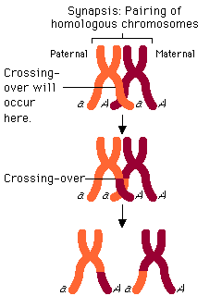
Crossing Over
Another way meiosis generates genetic variability is through the process of crossing-over between maternal and paternal chromatid pairs during prophase I.
As shown in the figures illustrating meiosis, crossing-over results in a physical exchange of equivalent segments of maternal and paternal homologous chromosomes.

Slide 30
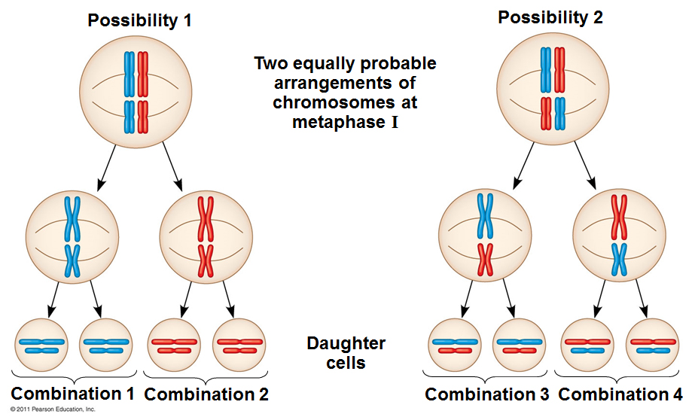
Independent Assortment

Slide 31
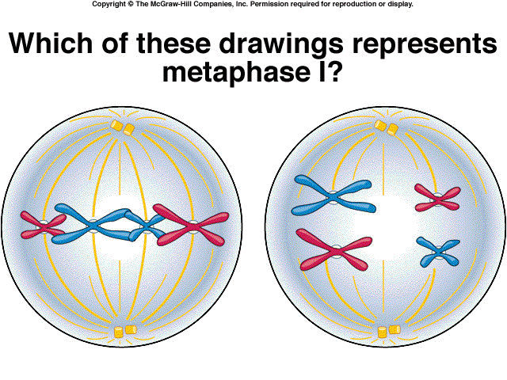
Metaphase in mitosis and meiosis
Mitosis
Metaphase 1 in meiosis

Slide 32
Differences between mitosis and meiosis
 | Mitosis | Meiosis
DIVISIONS
CHROMOSOME NUMBER
BIVALENTS
CHIASMATA
CROSSING OVER
DAUGHTER CELLS
NUMBER OF DAUGHTER CELLS
single division of chromosome and nucleus
single division of chromosome but double division of nucleus
remains the same
is halved
homologous chromosomes associate to form bivalents in prophase I
homologous chromosomes do not associate
never formed
may be formed
never occurs
may occur
identical to parent cells (in the absence of mutations)
genetically different from parent cells
two
four

Slide 33
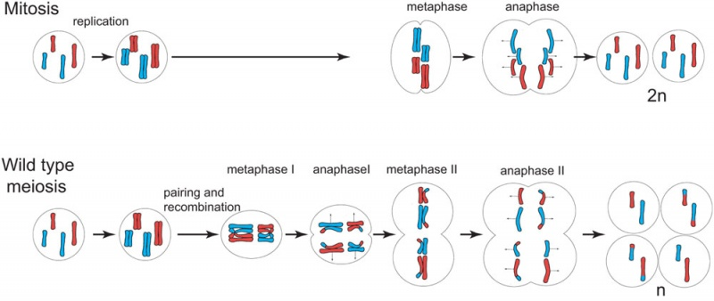

Slide 34
